Slide 1
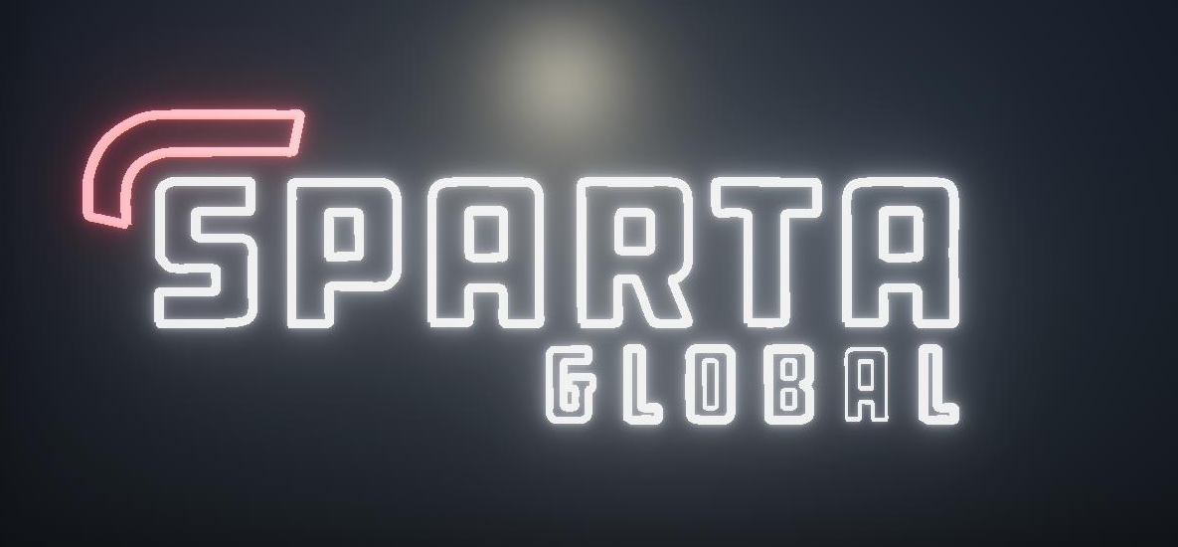

Sparta Simulation Project
Miguel António Fernandes Vieira
Sparta Consultant

Slide 2

Introduction
Software used and workflow
Problems found
Local Multiplayer
Code Highlights

Slide 3
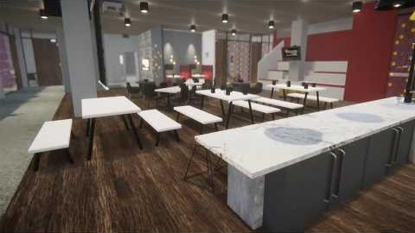

Slide 4
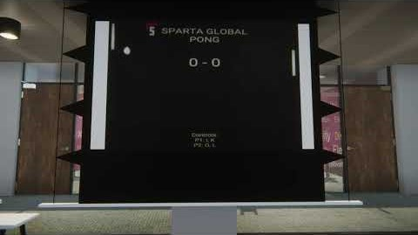

Slide 5

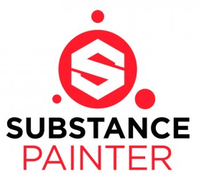

Software and Workflow
3D Modelling:
Autodesk Maya
Texture creation:
Substance Painter
Game Engine:
Unity 3D HDRP (High Def. Render Pipeline)

Slide 6
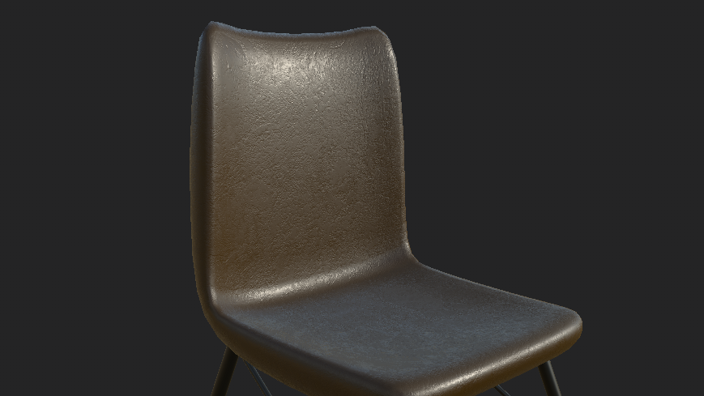
Texture Examples

Slide 7
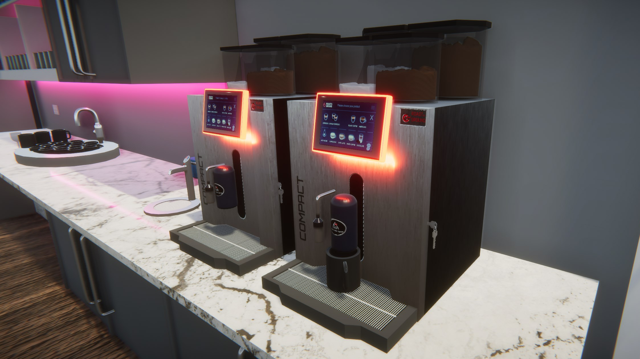

Slide 8
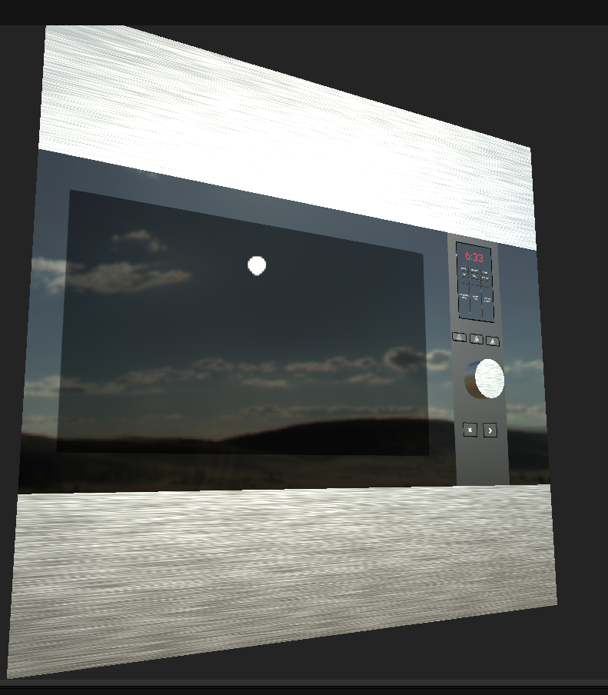

Slide 9
Problems Found

Slide 10
Local Multiplayer Mini Game

Slide 11
Code Highlights

